Slide 1
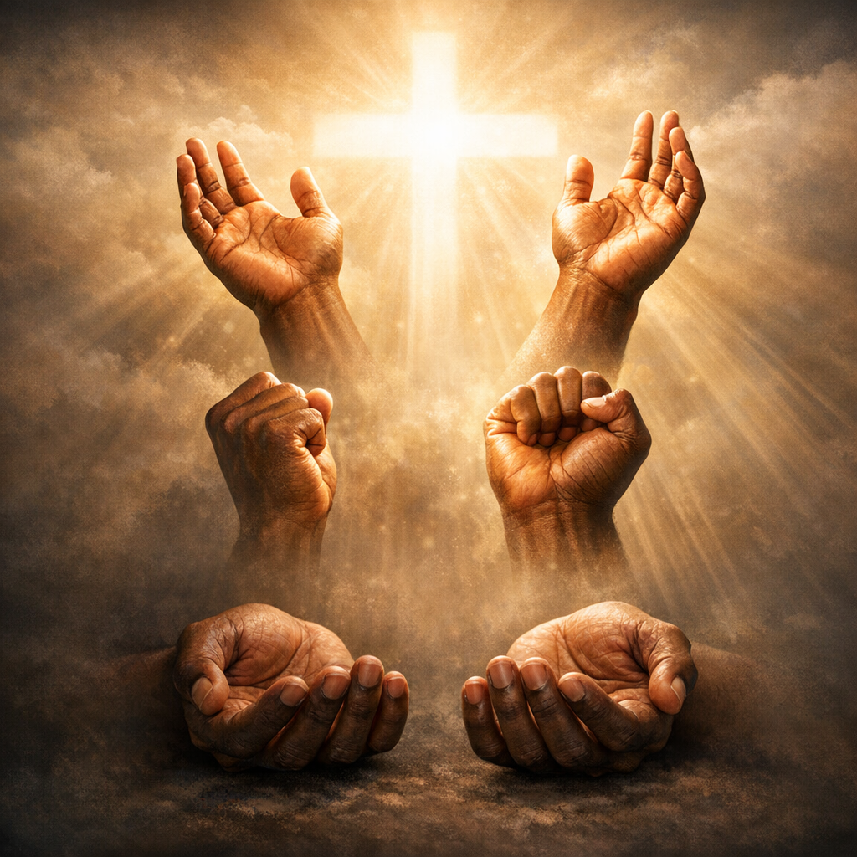
Don’t Let Your Hands Grow Weak
II Chronicles 15:7
Notes:
Stuart Fain ~ February 15, 2026

Slide 2
II Chronicles 15:7 (NKJV)
But you, be strong and do not let your hands be weak, for your work shall be rewarded!

Slide 3
II Chronicles 15:1-9 (NKJV)
¹ Now the Spirit of God came upon Azariah the son of Oded. ² And he went out to meet Asa, and said to him: "Hear me, Asa, and all Judah and Benjamin. The LORD is with you while you are with Him.

Slide 4
II Chronicles 15:1-9 (NKJV)
If you seek Him, He will be found by you; but if you forsake Him, He will forsake you. ³ For a long time Israel has been without the true God, without a teaching priest, and without law;

Slide 5
II Chronicles 15:1-9 (NKJV)
⁴ but when in their trouble they turned to the LORD God of Israel, and sought Him, He was found by them. ⁵ And in those times there was no peace to the one who went out, nor to the one who came in,

Slide 6
II Chronicles 15:1-9 (NKJV)
but great turmoil was on all the inhabitants of the lands. ⁶ So nation was destroyed by nation, and city by city, for God troubled them with every adversity.

Slide 7
II Chronicles 15:1-9 (NKJV)
⁷ But you, be strong and do not let your hands be weak, for your work shall be rewarded!" ⁸ And when Asa heard these words and the prophecy of Oded the prophet, he took courage,

Slide 8
II Chronicles 15:1-9 (NKJV)
and removed the abominable idols from all the land of Judah and Benjamin and from the cities which he had taken in the mountains of Ephraim; and he restored the altar of the Lord that was before the vestibule of the Lord.

Slide 9
II Chronicles 15:1-9 (NKJV)
⁹ Then he gathered all Judah and Benjamin, and those who dwelt with them from Ephraim, Manasseh, and Simeon, for they came over to him in great numbers from Israel when they saw that the LORD his God was with him.

Slide 10
Reproved by the Spirit:
Remember God’s Presence
Rise After Failure
Repair and Recommit

Slide 11
Point #1: Remember God’s Presence
Isaiah 40:31 (NASB)
Deuteronomy 31:6 (NASB)

Slide 12
Isaiah 40:31 (NASB)
Yet those who wait for the LORD Will gain new strength; They will mount up with wings like eagles, They will run and not get tired, They will walk and not become weary.

Slide 13
Deuteronomy 31:6 (NASB)
Be strong and courageous, do not be afraid or in dread of them, for the LORD your God is the One who is going with you. He will not desert you or abandon you.

Slide 14
Point #2: Rise After Failure
Proverbs 24:16 (NASB)
Philippians 3:13-14 (NASB)

Slide 15
Proverbs 24:16 (NASB)
For a righteous person falls seven times and rises again, But the wicked stumble in time of disaster.

Slide 16
Philippians 3:13-14 (NASB)
Brothers and sisters, I do not regard myself as having taken hold of it yet; but one thing I do: forgetting what lies behind and reaching forward to what lies ahead, I press on toward the goal for the prize of the upward call of God in Christ Jesus.

Slide 17
Point #3: Repair and Recommit
Psalms 119:11 (NASB)
Romans 12:1-2 (NASB)

Slide 18
Psalms 119:11 (NASB)
I have treasured Your word in my heart, So that I may not sin against You.

Slide 19
Romans 12:1-2 (NASB)
¹ Therefore I urge you, brothers and sisters, by the mercies of God, to present your bodies as a living and holy sacrifice, acceptable to God, which is your spiritual service of worship.

Slide 20
Romans 12:1-2 (NASB)
² And do not be conformed to this world, but be transformed by the renewing of your mind, so that you may prove what the will of God is, that which is good and acceptable and perfect.

Slide 21
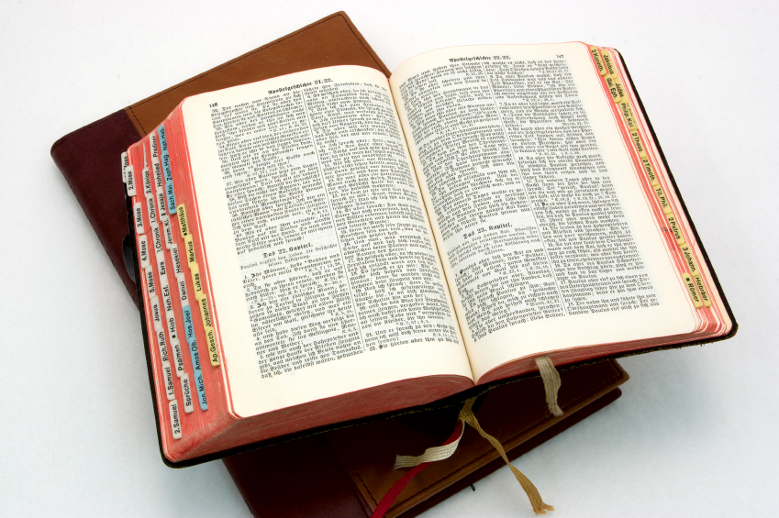
Hear: Romans 10:17
So then faith cometh by hearing, and hearing by the word of God.

Slide 22
Believe: Hebrews 11:6
But without faith it is impossible to please him: for he that cometh to God must believe that he is, and that he is a rewarder of them that diligently seek him.

Slide 23
Repent: Luke 13:3
I tell you, Nay: but, except ye repent, ye shall all likewise perish.

Slide 24
Confess: Matthew 10:32-33
32 Whosoever therefore shall confess me before men, him will I confess also before my Father which is in heaven.
33 But whosoever shall deny me before men, him will I also deny before my Father which is in heaven.

Slide 25
Baptize: Acts 22:16
And now why tarriest thou? arise, and be baptized, and wash away thy sins, calling on the name of the Lord.

